Slide 1
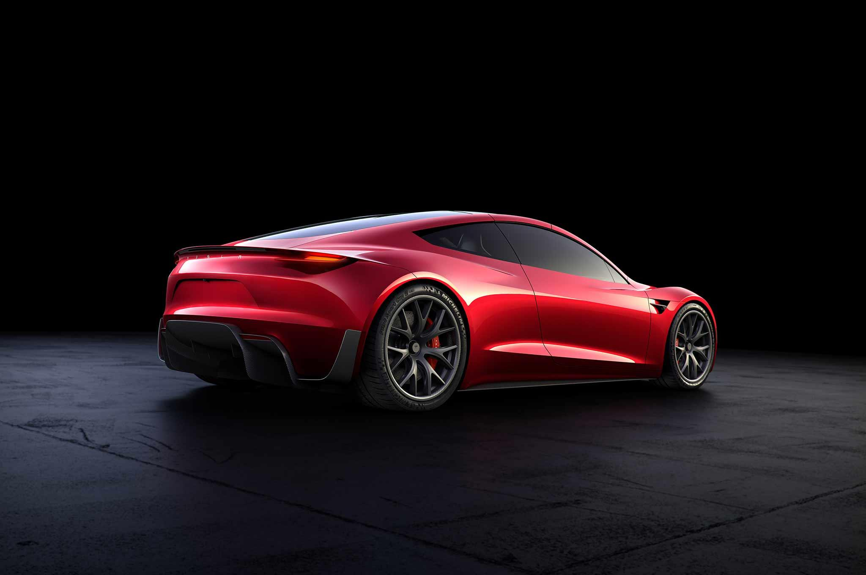
PiSmart-car
Sujith Polpaya
Vikas Shetty Nicholas Fong
Surya Chandrasekaran

Slide 2
The Problem
NHTSA: Nearly one-third of the 6 million auto accidents every year are rear-end collisions.
IIHS: Automatic Emergency Braking (AEB) reduces crashes & injuries by ~40%, and Forward Collision Warning (FCW) by ~23%.
2016: < 40% new cars offered FCW as standard, and only half of them had AEB as an option. By 2022 99% of new cars to have AEB.
BEV + autonomous cars to be mainstream and cheaper by 2020 - 2025. AEB well suited for BEV drivetrain w/ autonomous cars.
Speed, collision data can be shared across a connected car smart network.

Slide 3
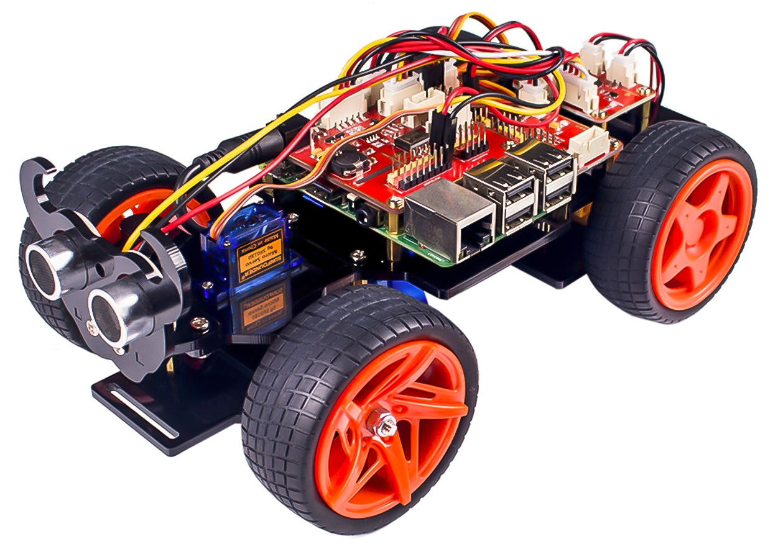
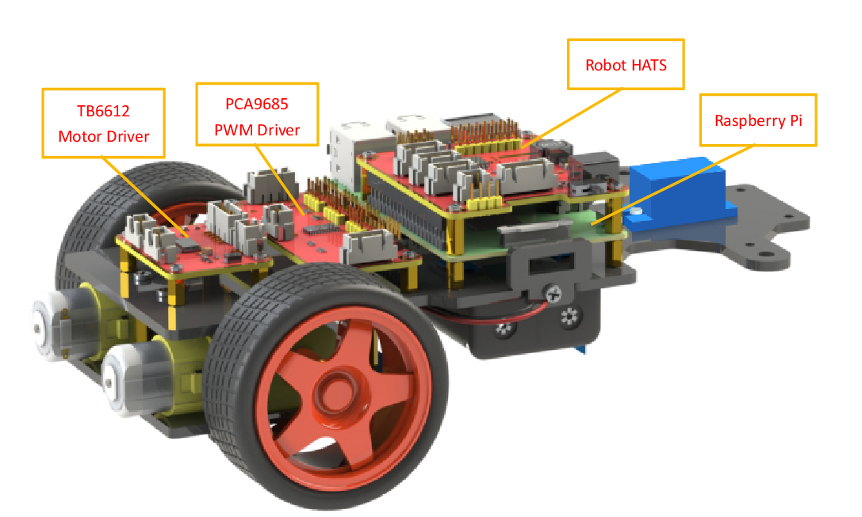
The Thing: Our Car
Connected car w/ collision prevention & avoidance, and SLW.
H/W: PiCar kit with Raspberry Pi 3 Model B powered by 2x 18650 Li-ion 3.7V 2600mAh batteries.
S/W: Raspbian Stretch w/ Python (drivers and logic).

Slide 4
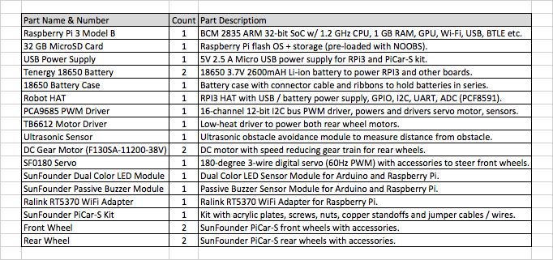
Bill of Materials

Slide 5
Collision Detection & Prevention
Collision Detection and Prevention logic based on production AEB features: Audi Pre Sense, BMW i series Driving Assistance features.
Upon detecting an obstacle in front, the car would first give a visual and audible warning (FCW), but if the driver still doesn’t respond, apply brake (AEB) when a crash is imminent (non-standardized implementations).
Real-world systems use arrays of sensors (ex: LiDAR).
PiSmart-car uses an ultrasonic proximity sensor.

Slide 6
Collision Avoidance
Collision Avoidance is a autonomous driving feature.
This is still experimental technology (Ex: Tesla, Waymo).
Use predictive algorithms to sense obstacles from far away, and then avoid it by turning away from the obstacle (ex: change lane).
This is implemented using sensors (Radar, LiDAR), sensor networks as well as advance map algorithms.
PiSmart-car uses the sensor distance to turn away.

Slide 7
Braking Distance Calculation
Braking distance is the safe distance at which brake needs to be applied, so that vehicle will come to complete stop without colliding with an obstacle.
Braking distance is primarily affected by velocity of the vehicle (v), and the coefficient of friction (𝛍) between the tires and the road surface.
Value of coefficient of friction (𝛍) is also dependent on vehicle mass, wind resistance etc.

Slide 8
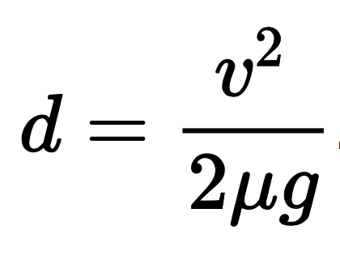
Braking Distance Formula
Formula used to calculate the braking distance:
d = minimum stopping distance
v = velocity of the vehicle
𝛍 = coefficient of friction between tires and the road
g = gravitational constant

Slide 9
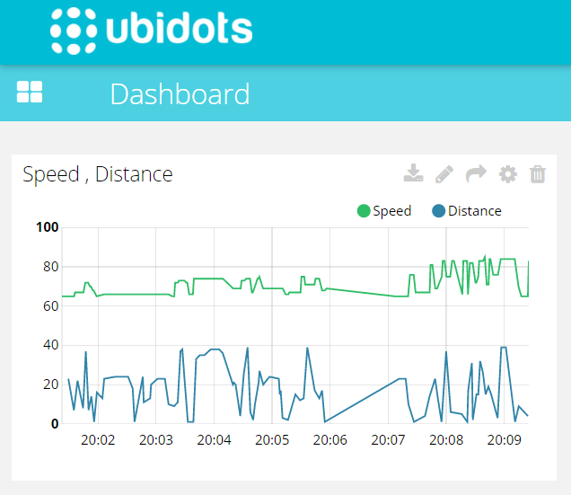
Connecting to the Cloud
Cloud backend with Ubidots.
Simple API to connect, display data, and perform actions using MQTT.
Notes:
Using our braking distance formula, we can detect when a collision is about to occur. Whenever this happens, we upload the car’s speed and distance to the cloud. We chose to use Ubidots as our cloud backend because of its simplicity. As the other group showed us in class a few weeks ago, using Ubidots is incredibly easy. The API is simple, clean and has a lot of documentation. In addition, generating graphs of your data and creating triggered alerts is very quick and easy to do. This graph shows some summary data from one of our test runs. We can also drill down into the data.

Slide 10
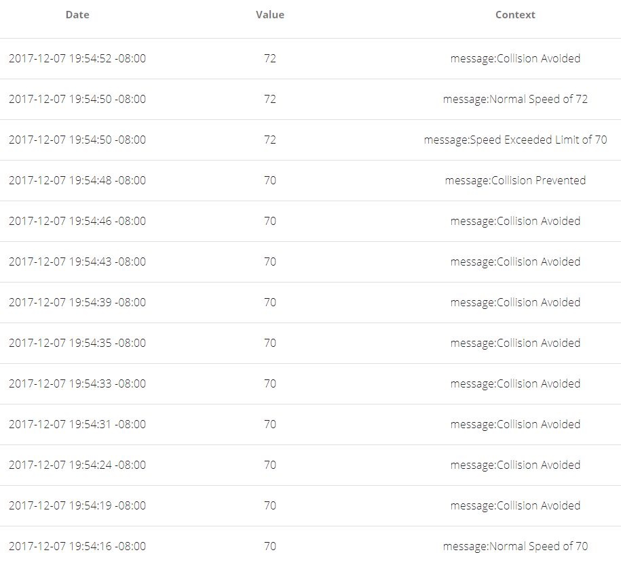
Cloud Data
Data sent by the car can facilitate data mining and analytics.
Connected services allows for more efficient routing and congestion control.
Smart network => faster, safer and energy efficient cars.
Notes:
Here, we can see each data point relating to the speed variable sent from the car to the cloud. We have the timestamp, the speed, and any related messages. This data collection and warehousing is very important, because this data can be used for data analytics. For example, if we also send the location data whenever our car has to step in to avoid a collision, we can identify patterns and find roads that are accident prone. Or, tracking the speeds of multiple cars will allow maps services like Google Maps or Waze to find faster routes. This is only going to be more and more useful as more and more cars connect to the cloud, allowing us to use data science to find safer, faster, and more efficient ways to drive. But this is all part of the future scope of our project, more practically something we’ve implemented is a speed limit warning.

Slide 11
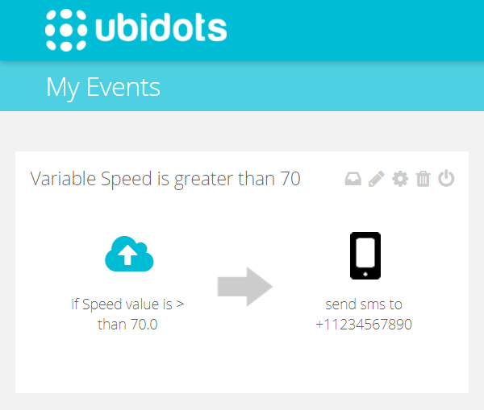
Speed Limit Warning
Speed Limit Warning (SLW): a visual alert on the car and another form of alert (ex: SMS), when the speed goes above a preset limit.
Great tool for parents with new teenage drivers to advocate safe driving habits.
Notes:
Ubidots has a useful feature that allows you to triggers an alert based on your data. For example, if we speed and go over 70 on the freeway, then Ubidots will automatically send a text alert to your phone number. While it may not be useful to text you specifically since it is illegal to use your phone while driving, this is practical if you have this setup to text your parents, spouse, or whoever may be in the passenger seat so that they can tell you to slow down. This accountability encourages safe driving habits, especially for young teens who are still learning how to drive and are too reckless to follow the speed limit. Our car also displays an orange light when speeding to provide immediate visual feedback to the driver. We hope future implementations of this can reduce the number of car related deaths.

Slide 12
Challenges / Lessons Learned
Ultrasonic sensor has accuracy and reliability issues. Must use camera + multiple sensors for better accuracy.
Raspbian + Python performance (ex: threading) not ideal. Mission critical applications like PiSmart-car must use RTOS + C/C++.
Challenging to calculate stopping distance w/ traditional physics formulas because of prototype h/w limitations.
Ubidots has latency issues, but passable as long as Ubidots thread given lower priority (lower QoS).

Slide 13
Roles
Sujith - H/W & collision detection + avoidance logic.
Vikas - Stopping distance calculation.
Nicholas - Ubidots / MQTT.
Surya - Some help w/ stopping distance calculation.

Slide 14
Demo

Slide 15
Thanks for Listening!
Questions?

Slide 16
References
“Automatic Emergency Braking .” Accessed 1 Dec 2017 www.safercar.gov/Vehicle-Shoppers/Safety-Technology/AEB/aeb
“Cars With Advanced Safety Systems.” Consumer Reports, 13 Sep 2017, www.consumerreports.org/car-safety/cars-with-advanced-safety-systems/
“Collision Avoidance System.” Wikipedia, Wikimedia Foundation, 16 Nov 2017,
https://en.wikipedia.org/wiki/Collision_avoidance_system
“Front Crash Prevention Cuts Rear-Enders.” IIHS HLDI, 28 Jan 2017, www.iihs.org/iihs/news/desktopnews/crashes-avoided-front-crash-prevention-slashes-police-reported-rear-end-crashes
Golson, Jordan. “Rear-End Crashes Go Way down When Cars Can Brake Themselves.” The Verge, The Verge, 27 Jan. 2016, www.theverge.com/2016/1/27/10854478/iihs-collision-warning-autobrake-volvo-city-safety-research
Halsey III, Ashley. “There Are about 1.7 Million Rear-End Collisions on U.S. Roads Each Year. Here’s How to Stop Them.” The Washington Post, WP Company, 8 Jun. 2015, www.washingtonpost.com/news/dr-gridlock/wp/2015/06/08/there-are-about-1-7-million-rear-end-collisions-on-u-s-roads-each-year-
heres-how-to-stop-them/
“Rear-End Collisions: The Most Common Type of Auto Accident in the U.S.” Tennessee Personal Injury Attorney Blog: Gilreath & Associates, 13 Apr. 2017, www.blog.sidgilreath.com/safety/rear-end-collisions-the-most-common-type-of-auto-accident-in-the-u-s.html
Shankleman, Jess. “The Electric Car Revolution Is Accelerating.” Bloomberg.com, Bloomberg, 6 July 2017, www.bloomberg.com/news/articles/2017-07-06/the-electric-car-revolution-is-accelerating

